Slide 1



Coronavirus State and Local Fiscal Recovery Fund Update
Washoe County Board of County Commissioners Meeting
September 28, 2021

Slide 2
Categories
$91M total
10-15%
Public Health – COVID Mitigation Efforts
Prevention in congregate settings (detention facility, shelter, childcare facilities)
Negative Economic Impacts
Aid to non-profit organizations
Services to Disproportionately Impacted Communities
Other economic support
Mobile vaccination clinic/command post
Homeless Services
UNR wastewater study
Infrastructure
Administrative and Revenue Replacement
Sewer & Water projects
Broadband
Affordable Housing Trust Fund
Child Care
10-15%
50+%
10-15%
5-10%

Slide 3

Guiding Principles
One-time projects and infrastructure.
​
Not used to escalate overhead expenses. ​
Collaborate with regional partners where possible.​
Projects that meet the following outcomes are ideal:​
  Transformational, innovative investments​
  Align with County Strategic Plan ​
  Achieve equitable outcomes​ & serve underserved populations​
  Solve community issues by attacking root causes (childcare, mental health, affordable housing)​

Slide 4

Progress Since August Update
Reports submitted 8/31/21 - https://www.washoecounty.gov/ARPA/
Executive Summary Document
State Treasurer collaboration and partnership
  Listening Sessions
  Survey
  Discussion September 30th

Slide 5
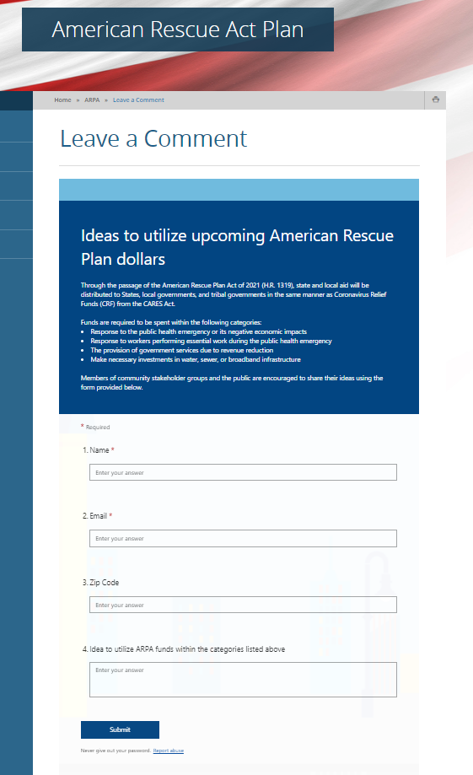
Progress Since August Update
Website Enhancements
  Leave a Comment/Project Idea
  Summary-Fact Sheet
Expedited Departmental Meetings/Process
  Implement immediate-need projects
  11 departments / 22 projects

Slide 6
TIMELINE
September 28, 2021
Second half/allocation to be received (May 2022) $45.7M
Now – Oct. 2021
January 2022
Jan. 2022→ 2027
Assess Community Needs
Identify Priority Projects
Implementation of Projects
&
Reporting Outcomes
Immediate priorities are bringing on staff to provide technical assistance to sub-grantees / community organizations and continuing to work through internal processes for identified projects (i.e. CIP and HR processes and procurement)
Reminder: funds must be allocated by December 2024 and expended by December 2026
Assess pressing
community needs
Involve local
solution providers
Begin allocation
of funds
Report progress
to community

Slide 7

Reporting / Status
Interim Report (financial) - DONE
  Overview of Status and Uses of Funding
  Expenditures and obligations through July 31, by category
  August 31, 2021, one-time report
Recovery Plan Performance Report - DONE
  By August 31, 2021 , and annually thereafter by July 31
Project & Expenditure Report – in progress
  Projects funded, expenditures, contracts & subawards $50k or more
  October 31, 2021, then 30 days after end each quarter thereafter

Slide 8
  Questions?
  Next presentation to BCC
  October 26, 2021

